Slide 1
Bunsen burners
21/02/2024
Year 7 Science

Slide 2
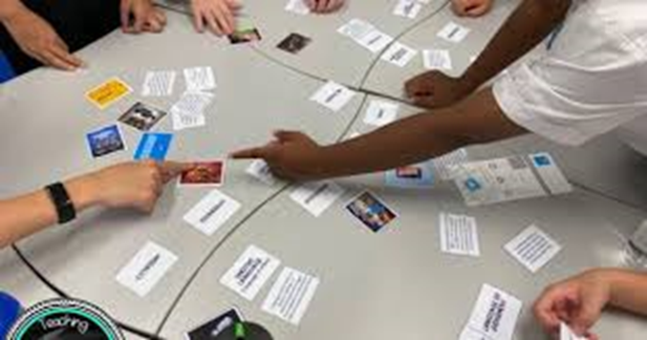
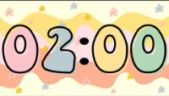
Review
Steps to lighting a Bunsen burner

Slide 3
Learning Intentions
Conduct experiments, ensuring safety and ethical guidelines are followed

Slide 4
Success criteria
Use equipment safely
Use correct units for measurements
Record data in tables

Slide 5
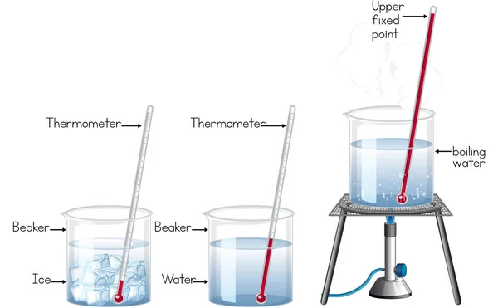
Hot, hotter, hottest

Slide 6
Success criteria
Use equipment safely
Use correct units for measurements
Record data in tables

Slide 7
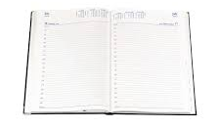
Don’t forget
Homework sheet – laboratory equipment
Due Monday 12 Feb

